Slide 1
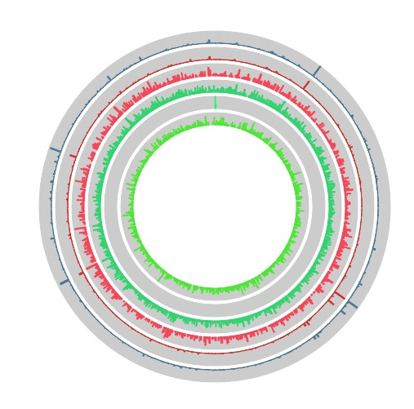
Transcriptomic characterization of Quahog Parasite Unknown (QPX) and the effects of temperature on gene expression
Annie Page-Karjian, Maya Groner, Jamie Sziklay, Ana Elisa Garcia, Ashton Griffin, Gregor-Fausto Siegmund, Sonia Singhal, Steven Roberts
Notes:
Annie

Slide 2
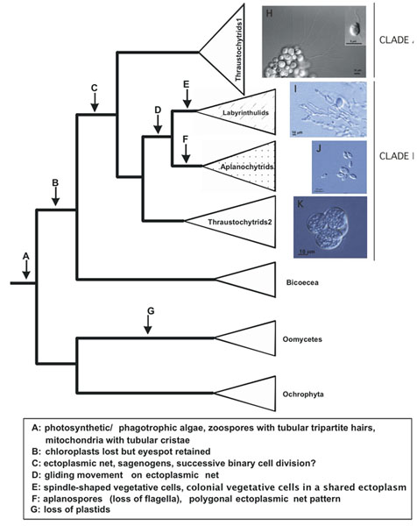
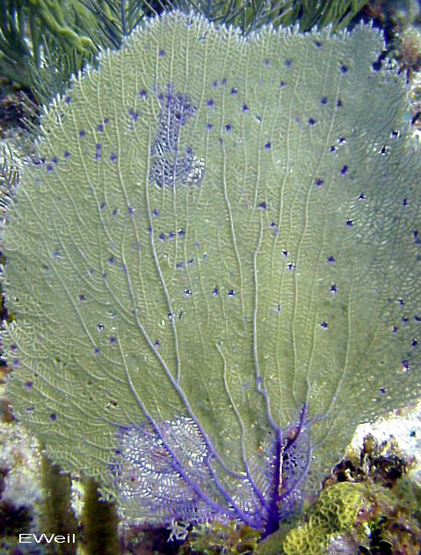
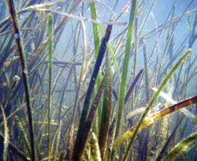
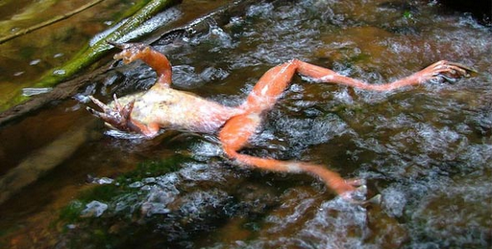
Thraustochytrids
- Unicellular protists
- Poorly described taxonomic group
- Mostly saprophytes, but includes some highly virulent pathogens
Notes:
Clades
Annie

Slide 3
QPX Pathology
- Massive inflammatory response
- Swelling and nodules mantle and labial palps
- Slower growth
Notes:
Typical QPX infection is characterized by a massive inflammatory response to the parasite that results in swellings and nodule formation in clam tissues. QPX infections are mostly observed in mantle and gill tissues but also can occur in the visceral mass (MacCallum and McGladdery, 2000; Ragone Calvo et al., 1998).
Annie

Slide 4
Perrigault M et al. 2010
Notes:
severe mortality episodes among wild and cultured hard clams have been associated with a disease caused by the protistan parasite QPX (Quahog Parasite Unknown). QPX was first observed in tissues of clam populations affected by unusual mortalities in New Brunswick, Canada in 1954 (Whyte et al., 1994). In 1989, it accounted for almost 100% of mortalities among cultured clams at Prince Edward Island (Whyte et al., 1994). QPX was thereafter identified in other locations further south: New Jersey in 1977 (Ford et al., 2002b), Massachusetts in 1995 (Smolowitz et al., 1998), Virginia in 1996 (Ragone Calvo et al., 1998), and New York in 2002 (Dove et al., 2004).
Cause of large-scale mortalities in hatchery reared and commercially harvested hard clam populations in several locations

Slide 5
Environment
Host
Disease
Pathogen
Notes:
Disease is often the result of the interaction between hosts, pathogens and their environment. Environmental parameters such as temperature, salinity, pH can affect both pathogen’s virulence and host’s ability to resist infections.
Genetic basis to correlate observations of virulence
transcriptome/genome
Economical and ecological importance
Comparative transcriptomics to look at mechanisms of virulence and pathogenesis
Possibly well-studied for major infectious diseases like influenza, but not for things like QPX (yet economically significant)- novel approach in marine diseases (bc of RNA Seq/genomic/transcriptomic data, it's really great)
Amt of sequence info provided is also awesome- tons of genomic resources
Implications of climate change on epizootics like QPX
Annie

Slide 6
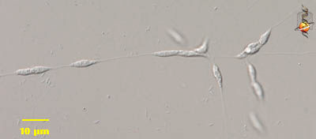
Brothers et al. 2000
Notes:
Previous studies have shown that…
Total number of QPX cells and total volume of mucus was optimal at 24°C
- QPX-infected clams exhibited differential immune responses at 21°C and 13°C
- In vitro QPX growth was optimal at 20°C - 23°C
Annie

Slide 7
Objectives of our study
1. Sequence and annotate the QPX transcriptome
2. Evaluate the effects of temperature on QPX gene expression
3. Identify biological function of enriched genes
Notes:
Ana

Slide 8
10 ˚C
21 ˚C
45,082,610
reads
Illumina Sequencing
30,035,397
reads
De novo assembly
11,280
contigs
RNA seq
2x
Enrichment analysis
613 genes are differentially expressed and associated with enriched processes!
Notes:
Ana

Slide 9
Objectives of our study
1. Sequence and annotate the QPX transcriptome
2. Evaluate the effects of temperature on QPX gene expression
3. Identify biological function of enriched genes
Notes:
Ana

Slide 10
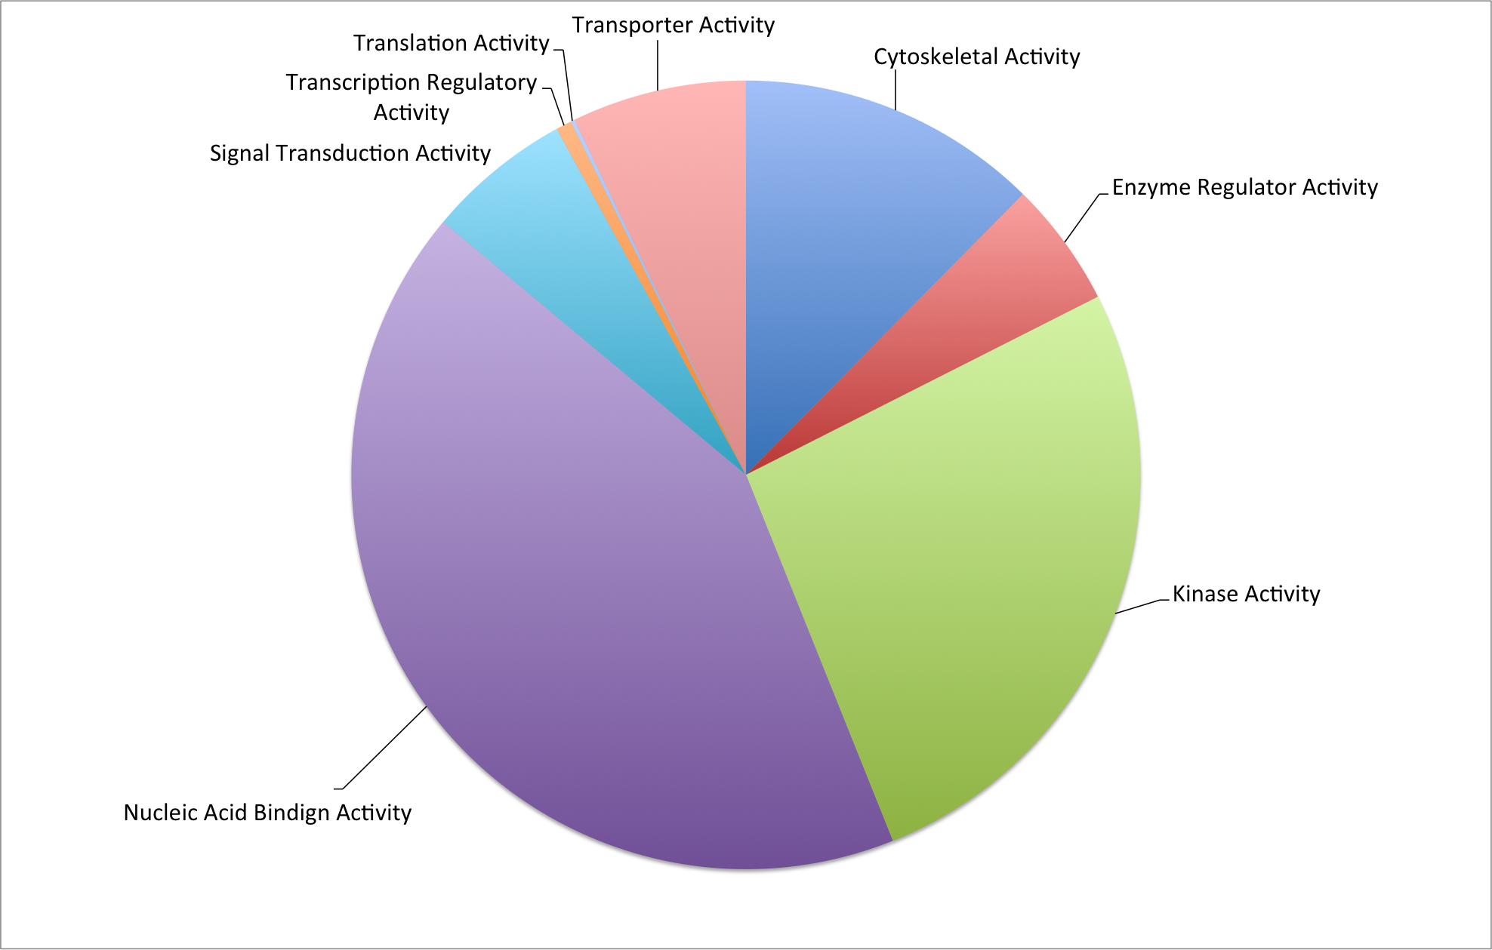
Results: Transcriptome characterization
Notes:
Ashton

Slide 11
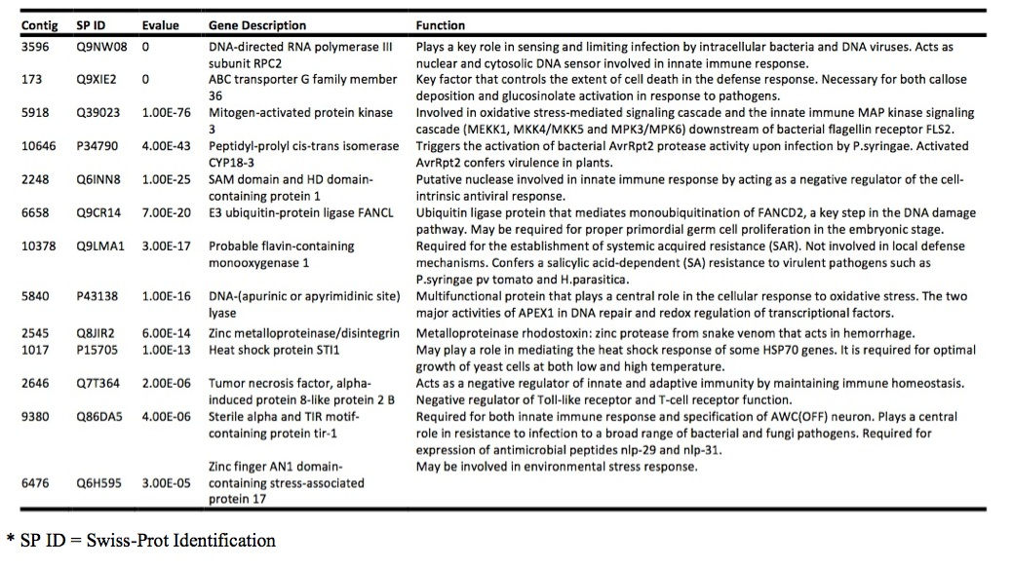
Results: Transcriptome characterization
Notes:
Jamie

Slide 12
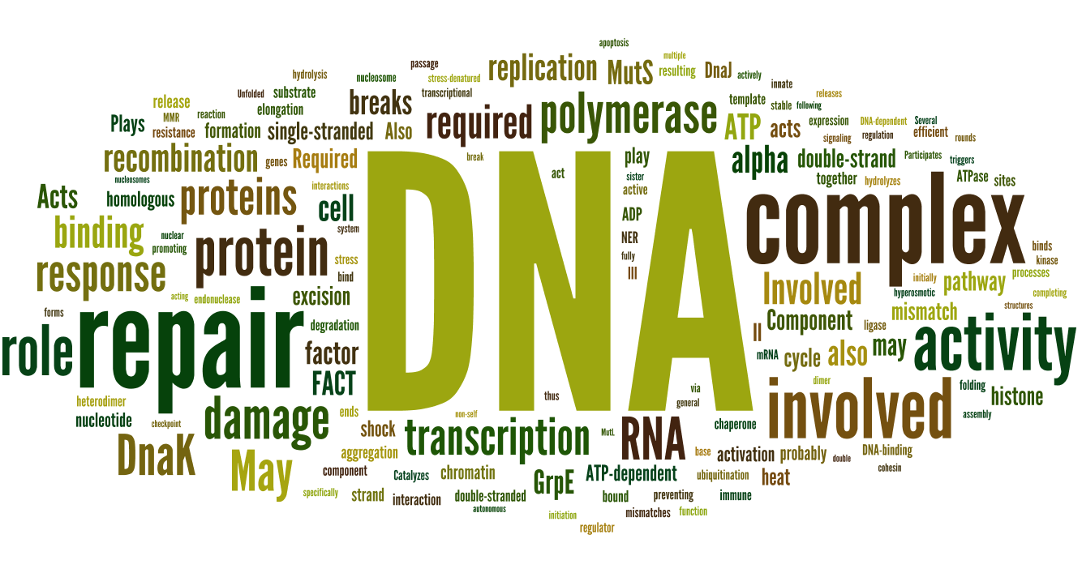
Notes:
Jamie

Slide 13
Objectives of our study
1. Sequence and annotate the QPX transcriptome
2. Evaluate the effects of temperature on QPX gene expression
3. Identify biological function of enriched genes
Notes:
Ana

Slide 14
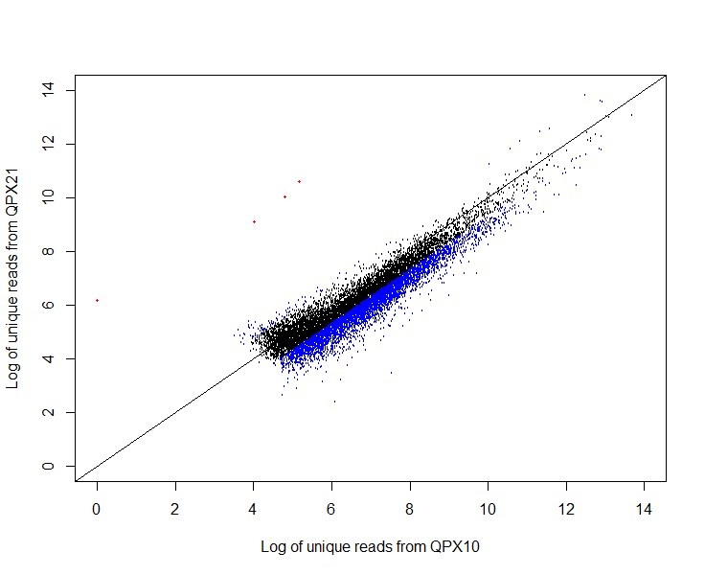
Results: Differential gene expression
Notes:
Sonia

Slide 15
Objectives of our study
1. Sequence and annotate the QPX transcriptome
2. Evaluate the effects of temperature on QPX gene expression
3. Identify biological function of enriched genes
Notes:
Ana

Slide 16
RESULTS: Enrichment analysis
Fold increase
Different biological processes
Notes:
Do we like this? Let me know! Ana

Slide 17
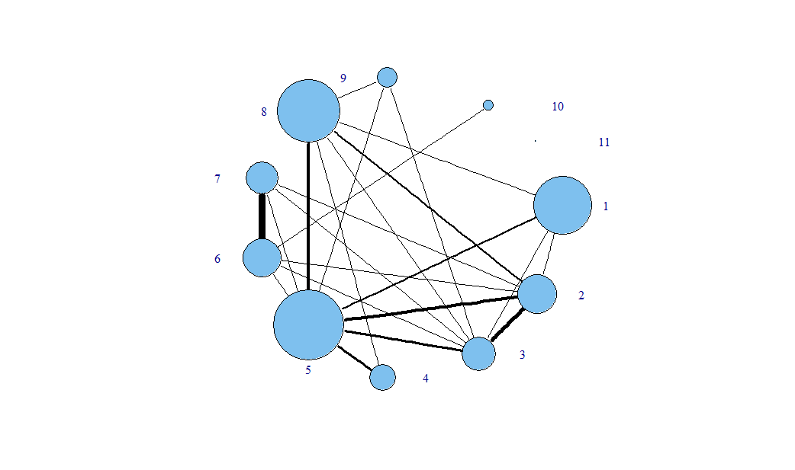
RESULTS: Genetic connections between processes
Developmental processes (4)
Protein metabolism (67)
Death (2)
Cell adhesion (1)
DNA metabolism (9)
Transport (49)
Stress response (13)
Cell cycle and proliferation (14)
RNA metabolism (110)
Cell organization and biogenesis (10)
Signal transduction (6)
Notes:
Connections observed in this graph represent 50% of all possible connections between nodes
Highly connected – can get from any node to any other node (barring Cell adhesion) in at most 3 steps
Highly clustered – ~ 70% of all nodes share neighbors. (Protein, Transport, RNA)
Use as a method to identify key genes/ areas of interest that overlap

Slide 18
RESULTS: THE PHYSIOLOGICAL LINK
Protein Folding
Ribosomal Biogenesis
Lipid Biosynthesis
Brothers et al. 2000
Notes:
Previous studies have shown that…
Total number of QPX cells and total volume of mucus was optimal at 24°C
- QPX-infected clams exhibited differential immune responses at 21°C and 13°C
- In vitro QPX growth was optimal at 20°C - 23°C
Annie

Slide 19
BONUS!

Slide 20
BONUS! Genome characterization
QPX
Phytophthora
Notes:
Gregor

Slide 21
Conclusions
Notes:
First genomic resources created for a pathogen in this taxanomic group using high throughput sequencing
First time a TC has been sequenced
First study to compare de novo assembly of transcriptome with genome
First time EVER this type of study was done in only 1.5 weeks!
Discuss QPX in light of differently regulated immune pathways in the Mercenaria mercenaria (apoptosis, reactive oxygen, oxidation-reduction process, biological adhesion)
First Genomic Characterization of species- amazing
Descriptive stats- most similar species blasted
- DEGs
- why up/down regulated genes are so
-Enriched Genes (Shoot & Lipo)- tables and discussion
-Ecology/climate change implications etc. Speculate/future research - compare to Mercenaria mercenaria genomic and transcriptomic analysis
Gregor

Slide 22
Environment
Host
Disease
Pathogen
Notes:
First genomic resources created for a pathogen in this taxanomic group using high throughput sequencing
First time a TC has been sequenced
First study to compare de novo assembly of transcriptome with genome
First time EVER this type of study was done in only 1.5 weeks!
Discuss QPX in light of differently regulated immune pathways in the Mercenaria mercenaria (apoptosis, reactive oxygen, oxidation-reduction process, biological adhesion)
First Genomic Characterization of species- amazing
Descriptive stats- most similar species blasted
- DEGs
- why up/down regulated genes are so
-Enriched Genes (Shoot & Lipo)- tables and discussion
-Ecology/climate change implications etc. Speculate/future research - compare to Mercenaria mercenaria genomic and transcriptomic analysis
Gregor

Slide 23
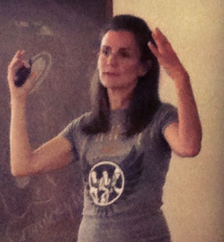
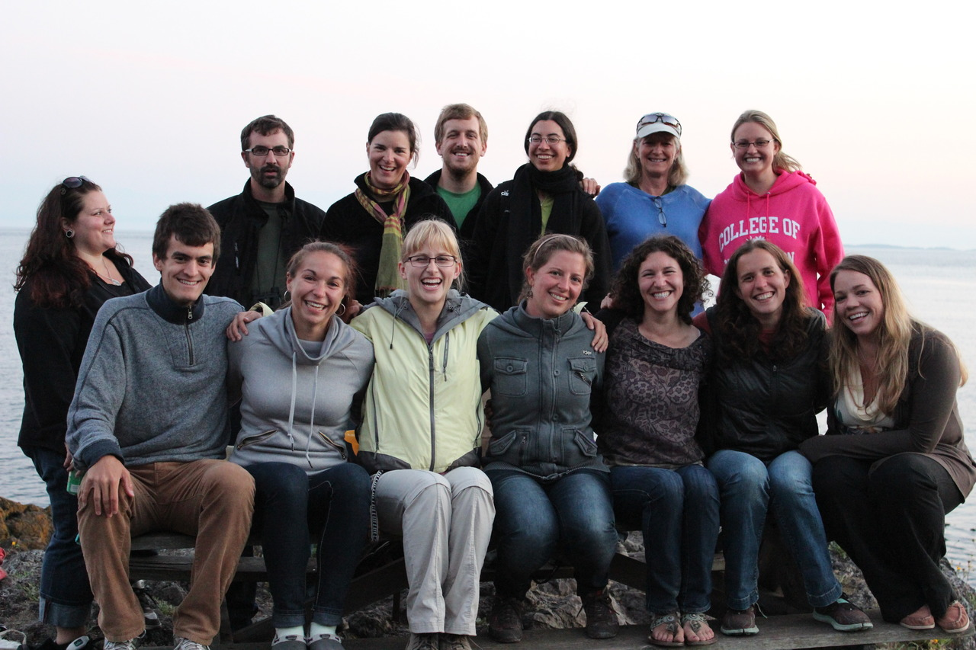
Acknowledgements

Slide 24
Questions?

